Slide 1

Chapter 2. Technical Mathematics
A PowerPoint Presentation by
Paul E. Tippens, Professor of Physics
Southern Polytechnic State University
© 2007

Slide 2
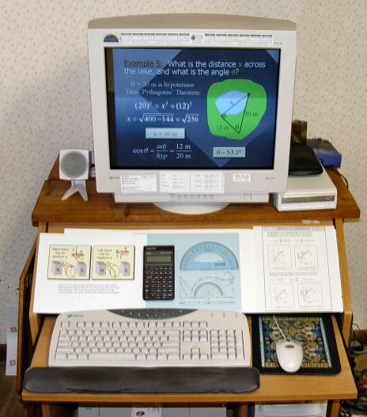
MATHEMATICS is an essential tool to the scientist or engineer. This chapter is a review of most of the skills that are necessary for understanding and applying physics. A thorough review is essential.

Slide 3
Preparatory Mathematics
Note: This module may be skipped based on individual needs of the user.
Basic geometry, algebra, formula rearrangement, graphing, trigonometry, scientific notation, and such are normally assumed for beginning physics.
If unsure, please at least run through the very focused review in this module.

Slide 4
Objectives: After completing this module, you should be able to:
Add, subtract, multiply, and divide signed measurements.
Solve and evaluate simple formulas for all parameters in an equation.
Work problems in Scientific Notation.
Construct and evaluate graphs.
Apply rules of geometry and trigonometry.

Slide 5
Addition of Signed Numbers
To add two numbers of like sign, sum the absolute values of the numbers and give the sum the common sign.
Example: Add (-6) to (-3) (-3) + (-6) = -(3 + 6) = -9
To add two numbers of unlike sign, find the difference of their absolute values and give the sign of the larger number.
  Example: Add (-6) to (+3). (+3) + (-6) = -(6 - 3) = -3

Slide 6
Arithmetic: Come on, man . . .
What’s up with this! I have no trouble with addition and subtraction. This is grade school, man!
Signed numbers!
Major Error Source!

Slide 7
Example 1. A force directed to the right is positive and a force to the left is negative. What is the sum of A + B + C if A is 100 lb, right; B is 50 lb, left; and C is 30 lb, left.
Given: A = + 100 lb; B = - 50 lb; C = -30 lb
A + B + C = (100 lb) + (-50 lb) + (-30 lb)
A + B + C = (100 lb) + (-50 lb) + (-30 lb)
A + B + C = +(100 lb - 50 lb - 30 lb)
-30 lb
A + B + C = +20 lb
100 lb
-50 lb
Net Force = 20 lb, right

Slide 8
Subtraction of Signed Numbers
To subtract one signed number b from another signed number a, change the sign of b and add it to a, using the addition rule.
Examples: Subtract (-6) from (-3):
(-3) - (-6) = -3 + 6 = +3
Subtract (+6) from (-3):
(-3) - (+6) = -3 - 6 = -9

Slide 9
Example 2. On a winter day, the temperature drops from 15⁰C to a low of -10⁰C. What is the change in temperature?
Given: t₀ = + 15⁰C; t_{f} = - 10⁰C
Δt = t_{f} - t₀
15⁰C
Δt = (-10⁰C) - (+15⁰C) = -10⁰C - 15⁰C = -25 C⁰
-10⁰C
Δt = -25 C⁰
What is the change in temperature if it rises back to +15⁰C?
Δt = +25 C⁰

Slide 10
Multiplication: Signed Numbers
If two numbers have like signs, their product is positive.
If two numbers have unlike signs, their product is negative.
Examples:
(-12)(-6) = +72 ; (-12)(+6) = -72

Slide 11
Division Rule for Signed Numbers
If two numbers have like signs, their quotient is positive.
If two numbers have unlike signs, their quotient is negative.
Examples:

Slide 12
Extension of Rule for Factors
The result will be positive if all factors are positive or if there is an even number of negative factors.
The result will be negative if there is an odd number of negative factors.
Examples:

Slide 13
Example 3: Consider the following formula and evaluate the expression for x when a = -1, b = -2, c = 3, d = -4.
x = -1 + 48
x = +47

Slide 14
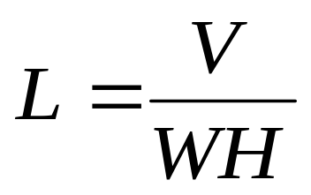
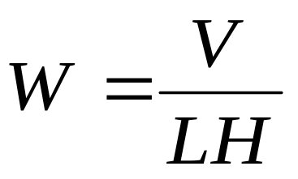
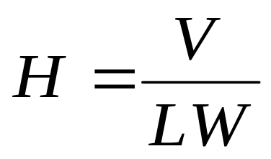
Working With Formulas:
Many applications of physics require one to solve and evaluate mathematical expressions called formulas.
Consider Volume V, for example:
H
V = LWH
W
L
Applying laws of algebra, we can solve for L, W, or H:

Slide 15
Algebra Review
A formula expresses an equality, and that equality must be maintained.
If x + 1 = 5 then x must be equal to 4 in order to maintain equality.
For example:
  Add or subtract the same value to both sides.
  Multiply or divide both sides by the same value.
  Square or take the square root of both sides.
Whatever is done to one side of an equation must be done to the other in order to main-tain equality.

Slide 16
Algebra With Equations
Formulas can be solved by performing a sequence of identical operations to both sides of an equality.
Terms may be added or subtracted from each side of an equality.
x + 4 - 6 = 2
(Example)
Subtract 4 and add 6 to each side
- 4 + 6 = -4 + 6
x = 2 - 4 + 6
x = +4

Slide 17
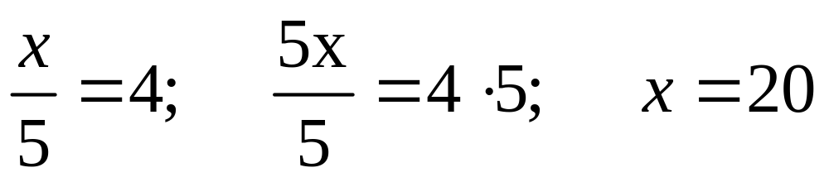
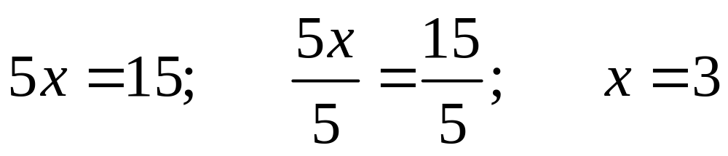
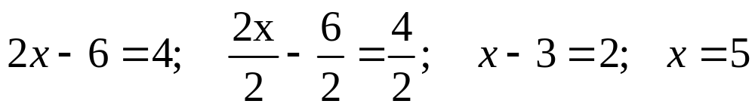
Equations (Cont.)
Each term on both sides can be multiplied or divided by the same factor.

Slide 18
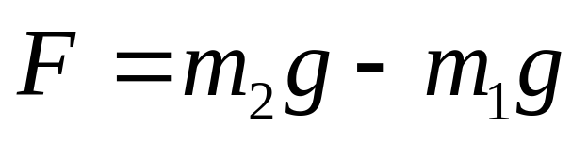
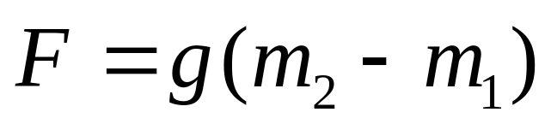
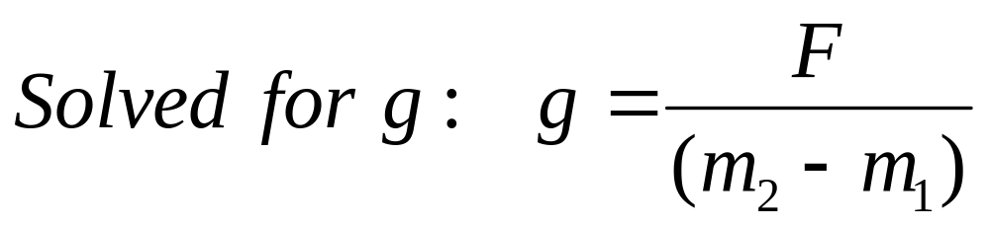
Equations (Cont.)
The same rules can be applied to literal equations (sometimes called formulas).
Solve for g:
Isolate g by factoring:
Divide both sides by: (m₂ – m₁)

Slide 19
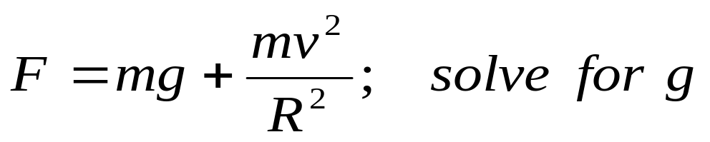
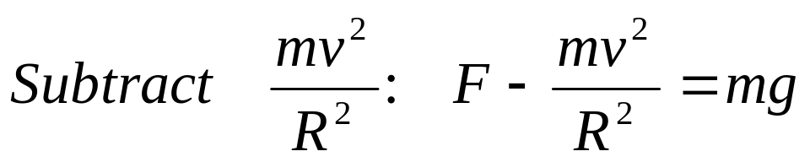
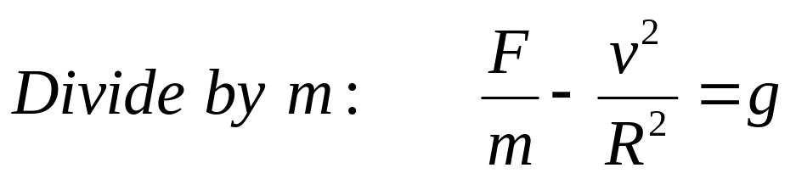
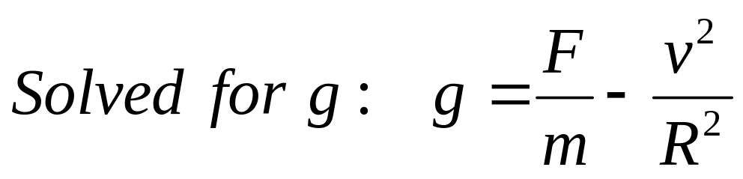
Equations (Cont.)
Now look at a more difficult one. (All that is necessary is to isolate the unknown.).

Slide 20
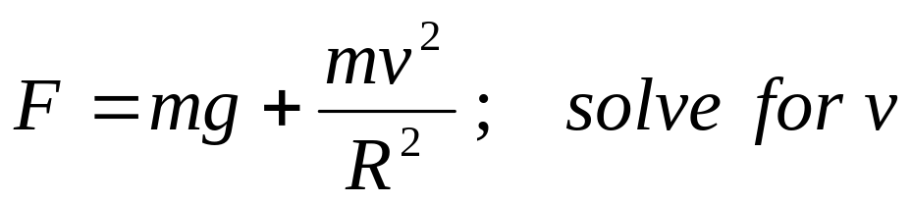
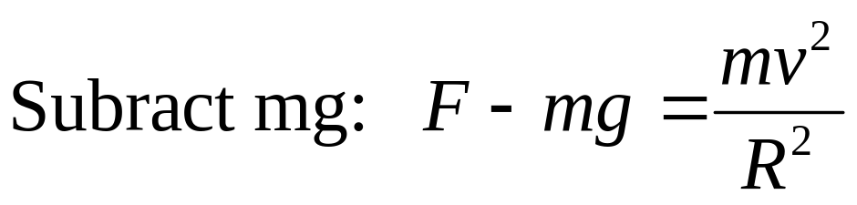
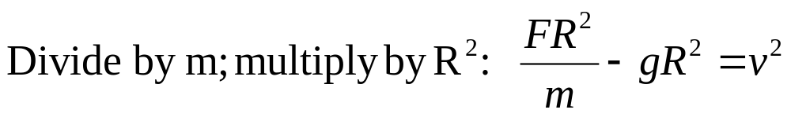
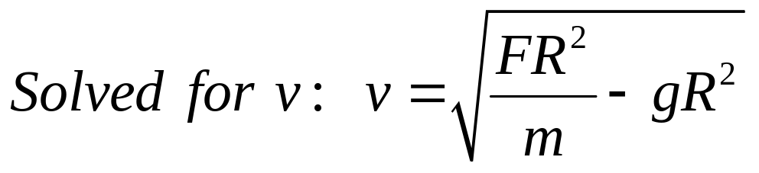
Equations (Cont.)
Each side may be raised to a power or the root may be taken of each side.

Slide 21
This is Getting Tougher!
Man . . . Arithmetic is one thing, but I gotta have help with solving for those letters.
Relax, Most physics
Formulas are simple

Slide 22
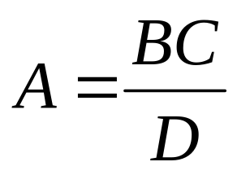
Formula Rearrangement
Consider the following formula:
Multiply by B to solve for A:
Notice that B has moved up to the right.
Thus, the solution for A becomes:

Slide 23
Next Solve for “D”
1. Multiply by “D”
2. Divide by “A”
3. Multiply by “B”
4. Solution for “D”
D moves up to left.
A moves down to right.
B moves up to right.
D is then isolated.

Slide 24
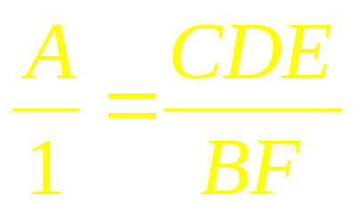
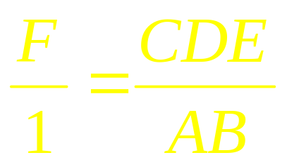
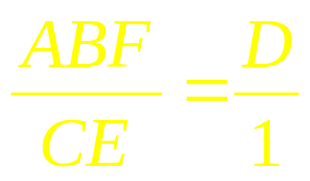
Cross Roads for Factors
When there are only two terms in a formula separated by an equals sign, the cross roads can be used.
Cross Roads for Factors Only!
Example solutions are given below:

Slide 25
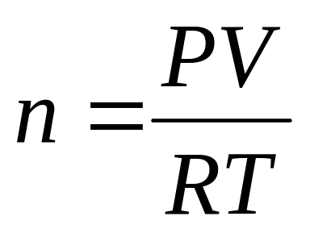
Example 4: Solve for n.
PV nRT
1 1
PV = nRT
=
n
R T
PV
R T
PV
n
=
=
R T
1
R T
1

Slide 26

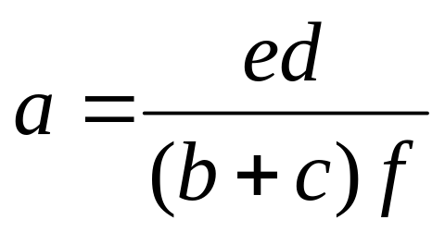
CAUTION SIGNS FOR CROSS ROADS
Caution
The cross-road method works ONLY for FACTORS!
The “c” cannot be moved unless the entire factor (b + c) is moved.
Solution for a:

Slide 27

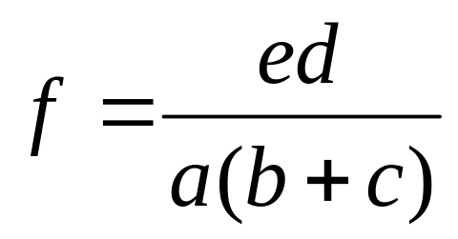
Example 5: Solve for f.
First move f to get it in numerator.
Next move a, d, and (b + c)

Slide 28
When to use Cross-Roads:
1. Cross roads works only when a formula has ONE term on each side of an equality.
2. Only FACTORS may be moved!

Slide 29


WARNING: DON’T SHOW THIS “CROSS ROADS” APPROACH TO A MATH TEACHER!
Use the technique because it works and is effective. Recognize the problems of confusing factors with terms.
BUT . . . Don’t expect all instructors to like it. Just use it quietly, and don’t tell anyone.

Slide 30
Often It is Necessary to Use Exponents in Physics Applications.
E = mc²
E = m ( c c )
The exponent “2” means “ c” times “c”
Volume of a cube of side x is “x x x” or
E = mc²
Cube of side x
V = x³

Slide 31
Bumpy Road Ahead !
Rules for Exponents and Radicals are difficult to apply—but necessary in physics notation.
Please fight your way through this review—ask for help if needed.

Slide 32
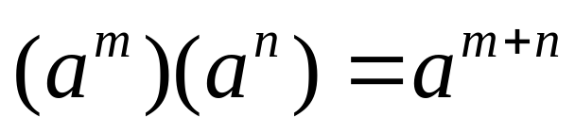
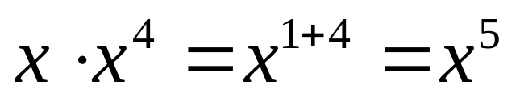
Exponents and Radicals Multiplication Rule
When two quantities of the same base are multiplied, their product is obtained by adding the exponents algebraically.
Examples:

Slide 33
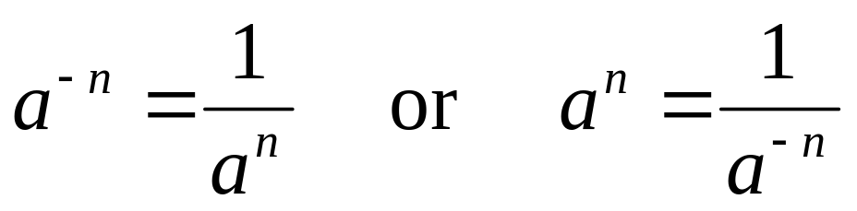
Exponent Rules
Negative Exponent: A term that is not equal to zero may have a negative exponent as defined below:
Examples:

Slide 34
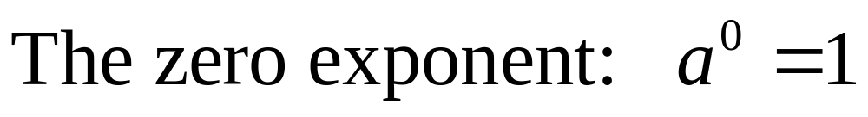
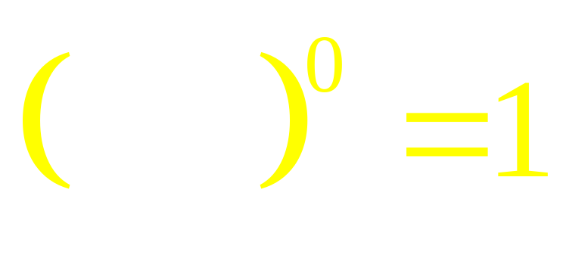
Exponents and Radicals Zero Exponent
Zero Exponent: Any quantity raised to the power of zero is equal to 1.
YES, that’s right
ANYTHING ! Raised to the zero power is “1”

Slide 35
Exponents and Radicals Zero Exponent
Zero Exponent: Consider the following examples for zero exponents.

Slide 36
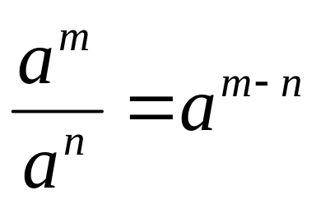
Other Exponent Rules
Division rule: When two quantities of the same base are divided, their quotient is obtained by subtracting the exponents algebraically.
Example:

Slide 37
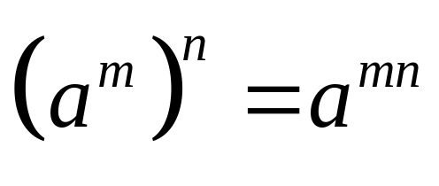
Exponent Rules (Continued):
Power of a Power: When a quantity a^{m} is raised to the power m:
Examples:

Slide 38
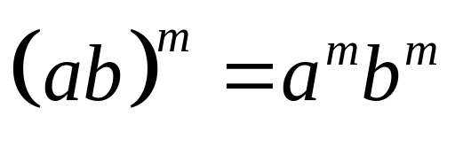
Exponent Rules (Continued):
Power of a product: Obtained by applying the exponent to each of the factors.
Example:

Slide 39
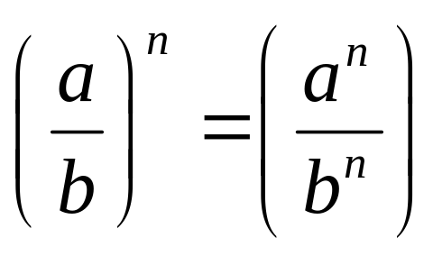
Exponent Rules (Continued):
Power of a quotient: Obtained by applying the exponent to each of the factors.
Example:

Slide 40
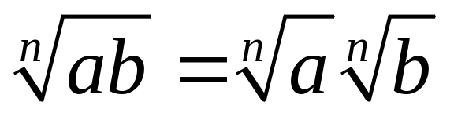
Roots and Radicals
Roots of a product: The nth root of a product is equal to the product of the nth roots of each factor.
Example:

Slide 41
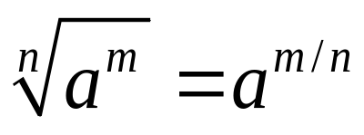
Roots and Radicals (Cont.)
Roots of a Power: The roots of a power are found by using the definition of fractional exponents:
Examples:

Slide 42
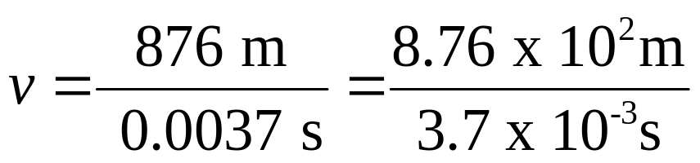
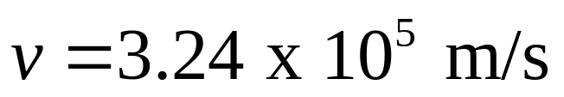
Scientific Notation
Scientific notation provides a short-hand method for expressing very small and very large numbers.
=
−
9
Examples:
0
.
000000001
10
0
.
000001
=
10
−
6
93,000,000 mi = 9.30 x 10⁷ mi
0
.
001
=
10
−
3
0.00457 m = 4.57 x 10⁻³ m
1
=
10
0
1000
=
10
3
1
,
000
,
000
=
10
6
1
,
000
,
000
,
000
=
10
9

Slide 43
Graphs
Direct relationship
Indirect relationship
Increasing values on the horizontal axis cause a proportional increase in values on the vertical axis.
Increasing values on the horizontal axis cause a proportional decrease in values on the horizontal axis.

Slide 44
Geometry
90º
Angles are measured in terms of degrees, from 0° to 360º.
Angle
180º
0º, 360º
Line AB is perpendicular to line CD
270º
A
Line AB is parallel to line CD
A
C
C
D
B
AB CD
AB CD
B
D

Slide 45
Geometry (Continued)
When two straight lines intersect, they form opposing angles which are equal.
B
A
A ′
B ′
Angle A = Angle A′
Angle B = Angle B ′
When a straight line intersects two parallel lines, the alternate interior angles are equal.
A
B
B ′
Angle A = Angle A′
Angle B = Angle B ′
A ′

Slide 46
Geometry (Cont.)
For any triangle, the sum of the interior angles is 180º
B
C
A
A + B + C = 180°
For any right triangle, the sum of the two smaller angles is 90º
B
C
A
A + B = 90°

Slide 47
Example 6: Use geometry to determine the unknown angles φ and θ in figure.
1. Draw helping lines AB and CD.
A
C
B
β
φ
2. Note: θ + 50⁰ = 90⁰
θ
θ = 40⁰
20⁰
50⁰
D
β = 20⁰
3. Alternate, interior angles are equal:
4. ACD is a right angle: β + φ + θ = 90⁰
20⁰ + φ + 40⁰ = 90⁰
φ = 30⁰

Slide 48
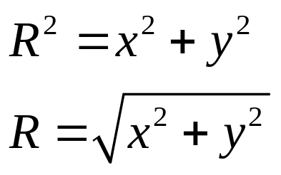
Right Triangle Trigonometry
Angles are often represented by Greek letters:
α alpha β beta γ gamma
θ theta φ phi δ delta
R
Pythagorean theorem
The square of the hypotenuse is equal to the sum of the squares of the other two sides.
y
x

Slide 49
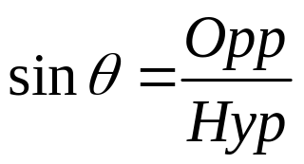
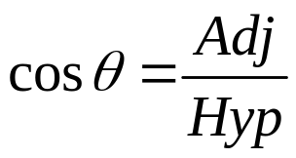
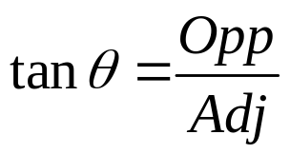
Right Triangle Trigonometry
The sine value of a right triangle is equal to the ratio of the length of the side opposite the angle to the length of the hypotenuse of the triangle.
hyp
θ
opp
adj
The cosine value of a right triangle is equal to the ratio of the length of the side adjacent to the angle to the length of the hypotenuse of the triangle.
The tangent value of a right triangle is equal to the ratio of the length of the side opposite the angle to the side adjacent to the angle.

Slide 50
Example 5: What is the distance x across the lake, and what is the angle θ?
R = 20 m is hypotenuse. Thus, Pythagoras’ Theorem:
x
20 m
12 m
θ
x = 16 m
θ = 53.1⁰

Slide 51
Summary
To add two numbers of like sign, sum the absolute values of the numbers and give the sum the common sign.
To add two numbers of unlike sign, find the difference of their absolute values and give the sign of the larger number.
To subtract one signed number b from another signed number a, change the sign of b and add it to a, using the addition rule.

Slide 52
Summary (Cont.)
If two numbers have like signs, their product is positive.
If two numbers have unlike signs, their product is negative.
The result will be positive if all factors are positive or if there is an even number of negative factors.
The result will be negative if there is an odd number of negative factors.

Slide 53
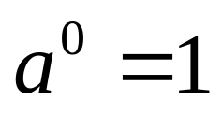
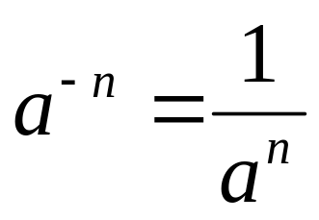
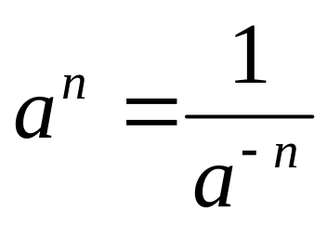
Summary
Working with Equations:
Add or subtract the same value to both sides.
Multiply or divide both sides by the same value
Square or take the square root of both sides.

Slide 54
Summary (Cont.)
Review sections on scientific notation, geometry, graphs, and trigonometry as needed.

Slide 55
Trigonometry Review
You are expected to know the following:
Trigonometry
y = R sin θ
R
y
x = R cos θ
θ
x
R² = x² + y²

Slide 56


Conclusion of Chap. 2 Technical Mathematics

